Slide 1
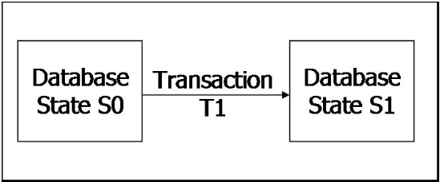
What is a Transaction?
A logical unit of work on a database
  An entire program
  A portion of a program
  A single command
The entire series of steps necessary to accomplish a logical unit of work
Successful transactions change the database from one CONSISTENT STATE to another
(One where all data integrity constraints are satisfied)

Slide 2
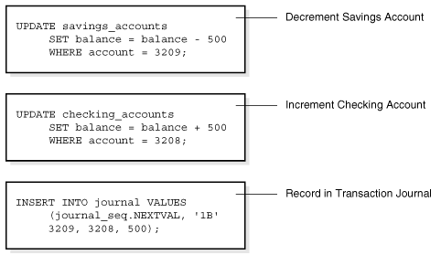
Example of a Transaction

Slide 3
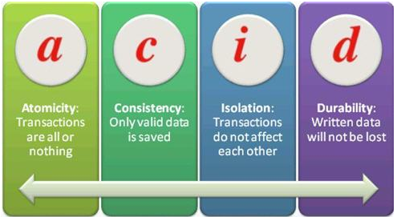
4 Properties of a Transaction
Atomic – All or Nothing
All parts of the transaction must be completed and committed or it must be aborted and rolled back
Consistent
Each user is responsible to ensure that their transaction (if executed by itself) would leave the database in a consistent state
Isolation
The final effects of multiple simultaneous transactions must be the same as if they were executed one right after the other
Durability
If a transaction has been committed, the DBMS must ensure that its effects are permanently recorded in the database (even if the system crashes)

Slide 4
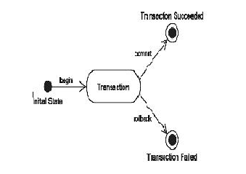
Transaction Management with SQL
A transaction needs to have a beginning and an end.
The end of a transaction is marked by either the SQL Statements → Commit or Rollback
When a transaction sequence is initiated it must continue through all succeeding SQL statements until:
  A Commit Statement is Reached
  A Rollback Statement is Reached
  The End of the Program is Reached (Commit)
  The Program is Abnormally Terminated (Rollback)

Slide 5
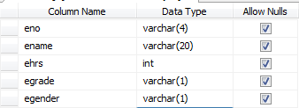
MS SQL Example
Create the following Table in an MS SQL database. Give it the name “employee”

Slide 6
Commit-MS SQL
Saves changes made.
  begin transaction
  use DB_USIU
  Insert employee values ('400', 'Jane', 4,'A','F')
  Insert employee values ('500', 'John', 7,'B','M')
  Update employee set ename = 'Mary' where Eno = ‘400‘
  commit transaction
Try the following:
  begin transaction
  use DB_USIU
  Insert employee values (‘600', ‘Mark', 3,’A‘,’M’)
  Insert employee values (‘700', ‘Paul', )
  Update employee set ename = ‘Tom' where Eno = ‘400‘
  commit transaction
Notice it will reject all statements even if the first one was correct.

Slide 7
Roll back-MS SQL
When the server encounters the rollback statement, it discards all changes in the transaction and returns the data to the state it was in before work began.
  begin transaction
  use employee
  Insert employee values (‘600', 'Jane', 4,’A‘,’F’)
  Insert employee values (‘700', 'John', 7,’B‘,’M’)
  Update employee set empname = 'Mary' where Empid = ‘700‘
  rollback transaction
  Notice it will reject all statements even if they were all correct

Slide 8
Example I Transaction
Examine current account balance
Consistent state before and after transaction
No changes made to Database
SELECT ACC_NUM, ACC_BALANCE
FROM CHECKACC
WHERE ACC_NUM = ‘0908110638’;
Notes:
6

Slide 9
Example II Transaction
Register credit sale of 100 units of product X to customer Y for $500
Consistent state only if both transactions are fully completed
Changes are made to the database
T1:
UPDATE PRODUCT
SET PROD_QOH = PROD_QOH - 100
WHERE PROD_CODE = ‘X’;
T2:
UPDATE ACCT_RECEIVABLE
SET ACCT_BALANCE = ACCT_BALANCE + 500
WHERE ACCT_NUM = ‘Y’;
Notes:
6

Slide 10
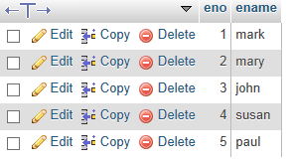
My SQL Example
Create the following innodb table with My SQL
The standard (MyISAM) table type is ideal for website use, where there are many reads in comparison to writes, and no transactions.
Where these conditions do not apply the InnoDB table is likely to be the table type of choice.
CREATE TABLE trans
(
eno int not null auto_increment,
ename varchar(30) not null,
primary key(eno)
)
Insert records as follows:
INSERT INTO trans (eno,ename) VALUES (NULL,’mark');
Notes:
CREATE TABLE trans
(
id int not null , sname varchar(30) not null
)type=innodb;

Slide 11
Example 1
  BEGIN;
  UPDATE trans SET ename ='Tom' WHERE eno=1;
  SELECT * FROM trans;
  COMMIT;
  Example 2
  BEGIN;
  UPDATE trans SET ename =‘Henry' WHERE eno=2;
  SELECT * FROM trans;
  ROLLBACK;

Slide 12
consistent reading - Reads committed data only
Window 1
  INSERT INTO trans (eno,ename) VALUES (NULL,'Njeri');
Window 2
SELECT * FROM trans
-> Window 2 shows changes because Autocommit = 1 by default

Slide 13
Window 1
  SET AUTOCOMMIT=0;
  INSERT INTO trans (eno,ename) VALUES (NULL,'Njeri');
Window 2
SELECT * FROM trans
-> Window 2 shows no changes because Autocommit = 0

Slide 14
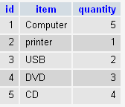
Transaction Programming
Using conditional programming constructs you can manipulate a transaction to handle special cases by committing or rolling back.
Create the following table called TRANS with MS SQL and insert the records shown
Create a transaction to execute the following.
  use Jsmith_Inventory;
  BEGIN TRANSACTION;
  UPDATE trans SET item='USB' WHERE id=1;
  IF
  (SELECT quantity FROM trans WHERE id=1 ) > 3
  commit
  ELSE rollback
  select * from trans

Slide 15
Savepoints
SQL Server enables you to mark a savepoint in a transaction. Savepoints let you to do some work inside a transaction and then roll back just that work, based on circumstances.
begin transaction
DECLARE @ErrorVar INT
insert TestEmployee values ('29', 'Martin','Mark','353345' )
save transaction EP /* mark a savepoint before each insert */
insert TestEmployee values ('29', 'Peter','Andrew','353345' )
SET @ErrorVar = @@ERROR
IF @ErrorVar <> 0
begin
print 'Incorrect insert…Last not saved'
rollback tran EP /* roll back just this item if incorrect */
end
else
begin
commit transaction
end

Slide 16
Transaction Log
Keeps track of all transactions that update the database
  Record for the beginning of the transaction
  Type of operation (insert / update / delete)
  Names of objects/tables affected by the transaction
  Before and After Values for Updated Fields
  Pointers to Previous and Next Transaction Log Entries for the same transaction
  The Ending of the Transaction (Commit)
Used for recovery in case of a Rollback
Notes:
A transaction log is a database – therefore it is managed by the DBMS like any other database. It is subject to database dangers like disk crashes. The transaction log contains some of the most critical data in a DBMS – attempts to reduce the risk of system failure should be implemented.

Slide 17
Concurrency Control
Coordination of simultaneous transaction execution in a multiprocessing database system
Ensure transaction serializability in a multi-user database
Lack of Concurrency Control can create data integrity and consistency problems:
  Lost Updates
  Uncommitted Data
  Inconsistent Retrievals

Slide 18
Lost Updates
Time | Jack’s Trans | Jill’s Trans | Balance
T1 | Begin
T2 | Read Balance | Begin | 1000
T3 |  | Read Balance | 1000
T4 | Bal = Bal – 50 (950) |  | 1000
T5 | Write Bal (950) | Bal = Bal + 100 (1100) | 950
T6 | Commit |  | 950
T7 |  | Write Bal (1100) | 1100
T8 |  | Commit | 1100

Slide 19
Uncommitted Data
Time | Deposit | Interest | Bal
T1 | Begin Transaction |  | 1000
T2 | Read Bal (1000) |  | 1000
T3 | Bal = Bal + 1000 (2000) |  | 1000
T4 | Write Bal (2000) | Begin Transaction | 2000
T5 |  | Read Bal (2000) | 2000
T6 |  | Bal = Bal*1.05 (2100) | 2000
T7 | Rollback |  | 1000
T8 |  | Write Bal (2100) | 2100
T9 |  | Commit | 2100

Slide 20
Inconsistent Retrievals
Time | SumBal | Transfer | Bal A | Bal B | Bal C | Sum
T1 | Begin Trans |  | 5000 | 5000 | 5000
T2 | Sum = 0 | Begin Trans | 5000 | 5000 | 5000
T3 | Read BalA (5000) |  | 5000 | 5000 | 5000
T4 | Sum = Sum + BalA (5000) | Read BalA (5000) | 5000 | 5000 | 5000
T5 | Read BalB (5000) | BalA = BalA -1000 (4000) | 5000 | 5000 | 5000
T6 | Sum = Sum+BalB (10000) | Write BalA (4000) | 4000 | 5000 | 5000
T7 |  | Read BalC | 4000 | 5000 | 5000
T8 |  | BalC =BalC + 1000 (6000) | 4000 | 5000 | 5000
T9 |  | Write BalC (6000) | 4000 | 5000 | 6000
T10 | Read BalC | Commit | 4000 | 5000 | 6000
T11 | Sum=Sum + BalC (16000) |  | 4000 | 5000 | 6000
T12 | Write Sum (16000) |  | 4000 | 5000 | 6000 | 16000
T13 | Commit |  | 4000 | 5000 | 6000 | 16000
Notes:
SumBal finds the sum of the balances of all three accounts – it does NOT UPDATE the account, but reads them
Transfer will transfer 1000 from Account A to Account C
Transfer Transaction executes correctly, however, the SumBal adds the same $1000 twice – once in A and Once in C

Slide 21
The Scheduler
Special DBMS Program to establish the order of operations in which concurrent transactions are executes
Interleaves the execution of database operations to ensure:
Serializability
Isolation of Transactions

Slide 22
The Scheduler
Bases its actions on Concurrency Control Algorithms (Locking / Time Stamping)
Ensures the CPU is used efficiently (Scheduling Methods)
Facilitates Data Isolation → Ensure that 2 transactions do not update the same data at the same time

Slide 23
Concurrency Control Algorithms
Locking
  A Transaction “locks” a database object to prevent another object from modifying the object
Time-Stamping
Assign a global unique time stamp to each transaction
Optimistic
Assumption that most database operations do not conflict

Slide 24
A. Locking
Lock guarantees exclusive use of data item to current transaction
Prevents reading Inconsistent Data
Lock Manager is responsible for assigning and policing the locks used by the transaction
Notes:
Most DBMS’s automatically initiate and enforce locking procedures through the lock manager

Slide 25
Types of Locks:
Binary
Binary Locks – Lock with 2 States
  Locked – No other transaction can use that object
  Unlocked – Any transaction can lock and use object
  All Transactions require a Lock and Unlock Operation for each Object Accessed (Handled by DBMS)
  Eliminates Lost Updates
  Too Restrictive to Yield Optimal Concurrency Conditions

Slide 26
Types of Locks:
Shared / Exclusive Locks
Indicates the Nature of the Lock
Shared Lock – Concurrent Transactions are granted READ access on the basis of a common lock
Exclusive Lock – Access is reserved for the transaction that locked the object
3 States: Unlocked, Shared (Read), Exclusive (Write)
More Efficient Data Access Solution
More Overhead for Lock Manager
  Type of lock needed must be known i.e. for the three Operations:
    Read_Lock – Check to see the type of lock
    Write_Lock – Issue a Lock
    Unlock – Release a Lock
  Allow Upgrading / Downgrading of Locks

Slide 27
Problems with Locking
Transaction Schedule May Not be Serializable
May Cause Deadlocks
  A deadlock is caused when 2 transactions wait for each other to unlock data

Slide 28
B. Time Stamping
Creates a specific order in which the transactions are processed by the DBMS
2 Main Properties
  Uniqueness – Assumes that no equal time stamp value can exist (ensures serializability of the transactions)
  Monotonicity – Ensures that time stamp values always increases
All operations within the same transaction have the same time stamp
If Transactions conflict, one is rolled back and rescheduled
Each value in Database requires 2 Additional Fields: Last Time Read / Last Time Updated
Increases Memory Need and Processing Overhead

Slide 29
Optimistic Method
Most database operations do not conflict
No locking or time stamping
Transactions execute until commit
  Read Phase – Read database, execute computations, make local updates (temporary update file)
  Validate Phase – Transaction is validated to ensure changes will not effect integrity of database
    If Validated → Go to Write Phase
    If Not Validated → Restart Transaction and discard initial changes
  Write Phase – Commit Changes to database
Good for Read / Query Databases (Few Updates)

Slide 30
Transaction Failure & Recovery
Transaction Failure
  Aborted transactions
  Incorrect Data
  System Failure
  Database Destruction
Transaction recovery
  Forward Recovery
  Backward Recovery
Notes:
47

Slide 31
Database Recovery Management
The recovery manager is a module of the DBMS hat restores the database to a correct condition when a failure occurs and then resumes processing after the user requests. Restores a database to previously consistent state
Backward recovery – The DBMS undoes unwanted changes to the database by returning the database to an earlier state. Used on a transaction that has aborted abnormally.
Forward Recovery – The DBMS starts with an earlier copy of the DBMS. After changes have been made if the database aborts abnormally the results of good transactions are committed. This is possible because an image of the transactions is always kept.
Forward recovery is preferred because it is more accurate and faster (The transactions do not have to be recreated)
Notes:
44

